Slide 1
ML Model - Employee Promotion Prediction
Shanmugapriyan G
Jan 03rd 2026

Slide 2
Problem Summary:
Predict whether an employee will be promoted based on historical HR data.
Dataset includes: employee demographics, performance metrics, training records, and award history.
Challenge: Imbalanced classes (~91% not promoted vs ~9% promoted).

Slide 3
Approach:
Data Analysis & EDA
Missing values imputed (mode or 0).
Duplicate rows removed to ensure clean data.
Explored distribution of features (numerical & categorical) and correlation.
Feature Engineering
Binary columns (KPIs_met >80%, awards_won?) standardized.
Derived features created:
training_efficiency
performance_index
kpi_per_training, awards_per_service
score_times_awards, score_times_kpi
Data Preparation
Split train/validation sets (80/20).
Pipelines:
Numeric features → median imputer
Categorical features → most frequent imputer + one-hot encoding

Slide 4
Model Development & Evaluation
Modeling Approach:
Considered models: Logistic Regression, Random Forest, AdaBoost
Final model: XGBoost (best F1 score on validation). Refer the next slides.
Handling Class Imbalance:
SMOTE oversampling to balance minority class (~60% of majority).
Threshold Tuning:
Predicted probabilities converted to binary labels.
Thresholds 0.1–0.9 to maximize F1.
Best threshold captured in model artifact for deployment.
Evaluation:
Validation F1-score reported
Predictions on test set saved to submission.csv
Note:
Instead of GridSearchCV, we manually tuned the key parameters because hyperparameter search didn’t improve performance in our case.
Custom threshold tuning - probability threshold (0.1–0.9) to maximize F1 score; Outperformed default 0.5

Slide 5
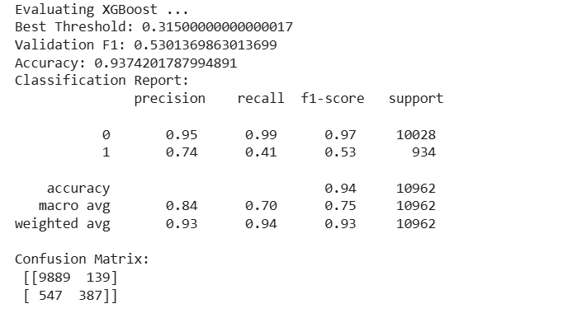
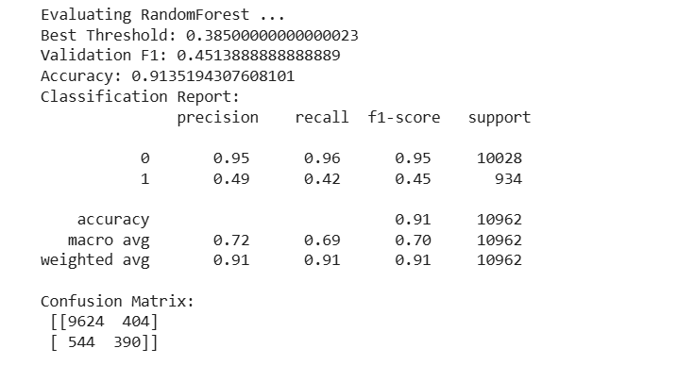
Comparison score of Different Models:
XGBoost
Random Forest

Slide 6
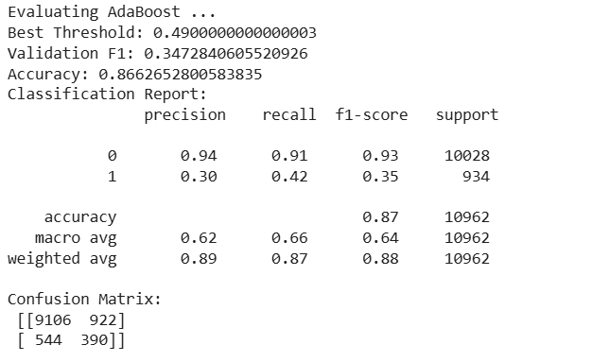
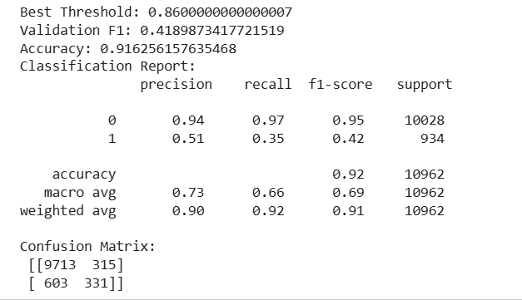
AdaBoost
Logistic Regression

Slide 7
Deployment
Streamlit UI:
Dropdowns, sliders, numeric inputs for employee features
Predict button calculates promotion probability and displays status.
FastAPI API:
/predict endpoint for external integration
Uses Pydantic aliases to handle special characters in features (KPIs_met >80%, awards_won?)
Model Storage:
Saved via joblib as artifact containing:
Trained pipeline
Best probability threshold

Slide 8
Deployed Links
GCP Streamlit Link - https://employee-promotion-prediction-streamlit-165135154152.us-east1.run.app/
GCP FastAPI Link - https://employee-promotion-prediction-fastapi-165135154152.us-east1.run.app
Github Streamlit Link - https://github.com/ShanmugapriyanG/Employee_Promotion_Prediction_Streamlit
Github FastAPI Link - https://github.com/ShanmugapriyanG/Employee_Promotion_Prediction_FastAPI/tree/main

Slide 9
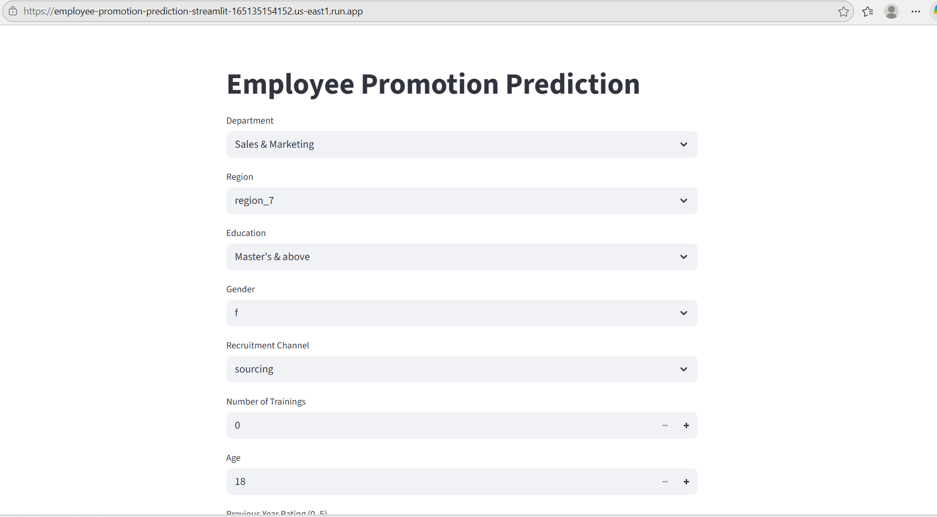
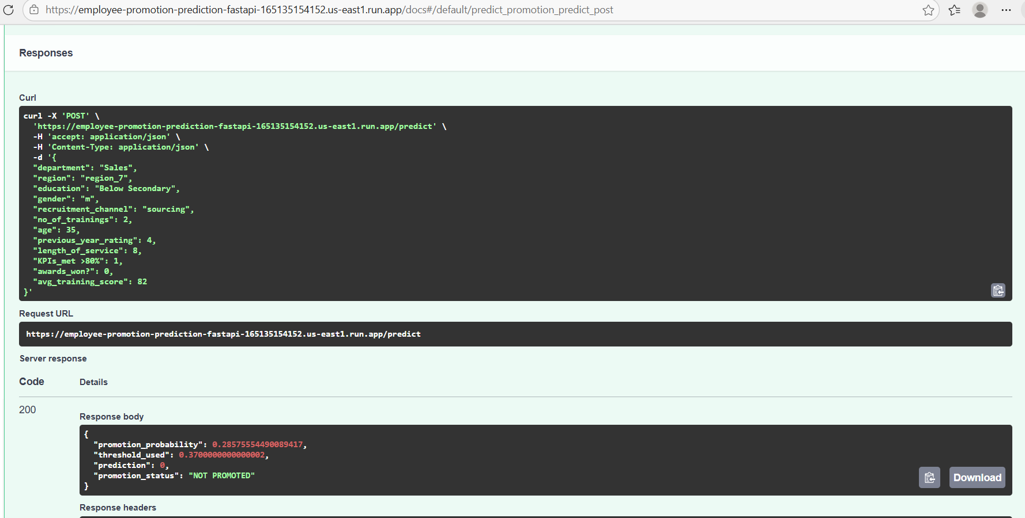
Screenshots:

Slide 10
Findings & Recommendations:
Strong predictors of promotion: avg_training_score, KPIs_met >80%, awards_won?
Interaction/Derived features improved model performance.
Future improvements - Evaluate additional algorithms (LightGBM, CatBoost)
Conclusion:
By creating meaningful features, handling class imbalance, using XGBoost and fine-tuning the prediction threshold, I built a model that can reliably predict which employees are likely to be promoted.

